Slide 1

Distribution of Loss of Load Events in 2017 IRM PBC
Mike Welch
Planning Engineer, Reliability Planning
NYSRC ICS
March 1, 2017
Rensselaer, NY

Slide 2
Case Description
2017 IRM Preliminary Base Case (PBC)
1500 Replications
NYCA LOLE of 0.0998
Summer Peak Load Forecast from 2016 GB
Zone J: 11,795 MW
Zone K: 5,422 MW
G – J Locality: 16,313 MW
NYCA: 33,363 MW

Slide 3
IRM 2017 PBC Results
Load Level |  | Base Shape | Weight | NYCA Daily Events | NYCA LOLE (dys/yr)
1 | (Highest) | 2006 | 0.0062 | 4,138 | 0.0171
2 |  | 2002 | 0.0606 | 1,731 | 0.0699
3 |  | 2007 | 0.2417 | 62 | 0.0100
4 |  | 2007 | 0.3830 | 8 | 0.0020
5 |  | 2007 | 0.2417 | 4 | 0.0006
6 |  | 2007 | 0.0606 | 1 | 0.0000
7 | (Lowest) | 2007 | 0.0062 | 0 | 0
Total: |  |  | 1.0000 | 5,944 | 0.0998

Slide 4
IRM 2017 PBC Results
NYCA LOLE (dys/yr)
Load Level | JAN | FEB | MAR | APR | MAY | JUN | JUL | AUG | SEP | OCT | NOV | DEC | Annual
1 | 0 | 0 | 0 | 0 | 0 | 0.0000 | 0.0020 | 0.0151 | 0 | 0 | 0 | 0 | 0.0171
2 | 0 | 0 | 0 | 0 | 0.0000 | 0.0002 | 0.0181 | 0.0515 | 0 | 0.0000 | 0 | 0 | 0.0699
3 | 0 | 0 | 0 | 0 | 0.0002 | 0.0003 | 0.0015 | 0.0077 | 0.0003 | 0 | 0 | 0 | 0.0100
4 | 0 | 0 | 0 | 0 | 0 | 0 | 0.0003 | 0.0015 | 0.0003 | 0 | 0 | 0 | 0.0021
5 | 0 | 0 | 0 | 0 | 0 | 0 | 0 | 0.0007 | 0 | 0 | 0 | 0 | 0.0007
6 | 0 | 0 | 0 | 0 | 0 | 0 | 0 | 0.0000 | 0 | 0 | 0 | 0 | 0.0000
7 | 0 | 0 | 0 | 0 | 0 | 0 | 0 | 0 | 0 | 0 | 0 | 0 | 0
Total: | 0 | 0 | 0 | 0 | 0.0002 | 0.0006 | 0.0218 | 0.0765 | 0.0006 | 0.0000 | 0 | 0 | 0.0998

Slide 5
IRM 2017 PBC Results
NYCA LFU-Adjusted Load (MW)
Load Level | JAN | FEB | MAR | APR | MAY | JUN | JUL | AUG | SEP | OCT | NOV | DEC
1 | 24,514 | 24,551 | 24,341 | 21,404 | 28,733 | 30,072 | 35,149 | 37,278 | 25,858 | 23,788 | 23,566 | 25,546
2 | 22,467 | 21,963 | 21,475 | 23,415 | 25,130 | 33,442 | 35,641 | 36,223 | 31,165 | 27,627 | 23,236 | 25,252
3 | 23,841 | 24,885 | 24,340 | 20,758 | 26,521 | 33,596 | 34,186 | 34,891 | 31,057 | 27,693 | 22,513 | 24,600
4 | 23,418 | 24,444 | 23,909 | 20,390 | 25,187 | 31,908 | 32,466 | 33,127 | 29,500 | 26,302 | 22,114 | 24,164
5 | 22,879 | 23,881 | 23,358 | 19,920 | 23,775 | 30,121 | 30,646 | 31,262 | 27,853 | 24,830 | 21,604 | 23,607
6 | 22,151 | 23,121 | 22,615 | 19,287 | 22,337 | 28,299 | 28,789 | 29,360 | 26,175 | 23,329 | 20,917 | 22,856
7 | 21,236 | 22,166 | 21,681 | 18,490 | 21,023 | 26,634 | 27,094 | 27,630 | 24,638 | 21,962 | 20,053 | 21,912

Slide 6
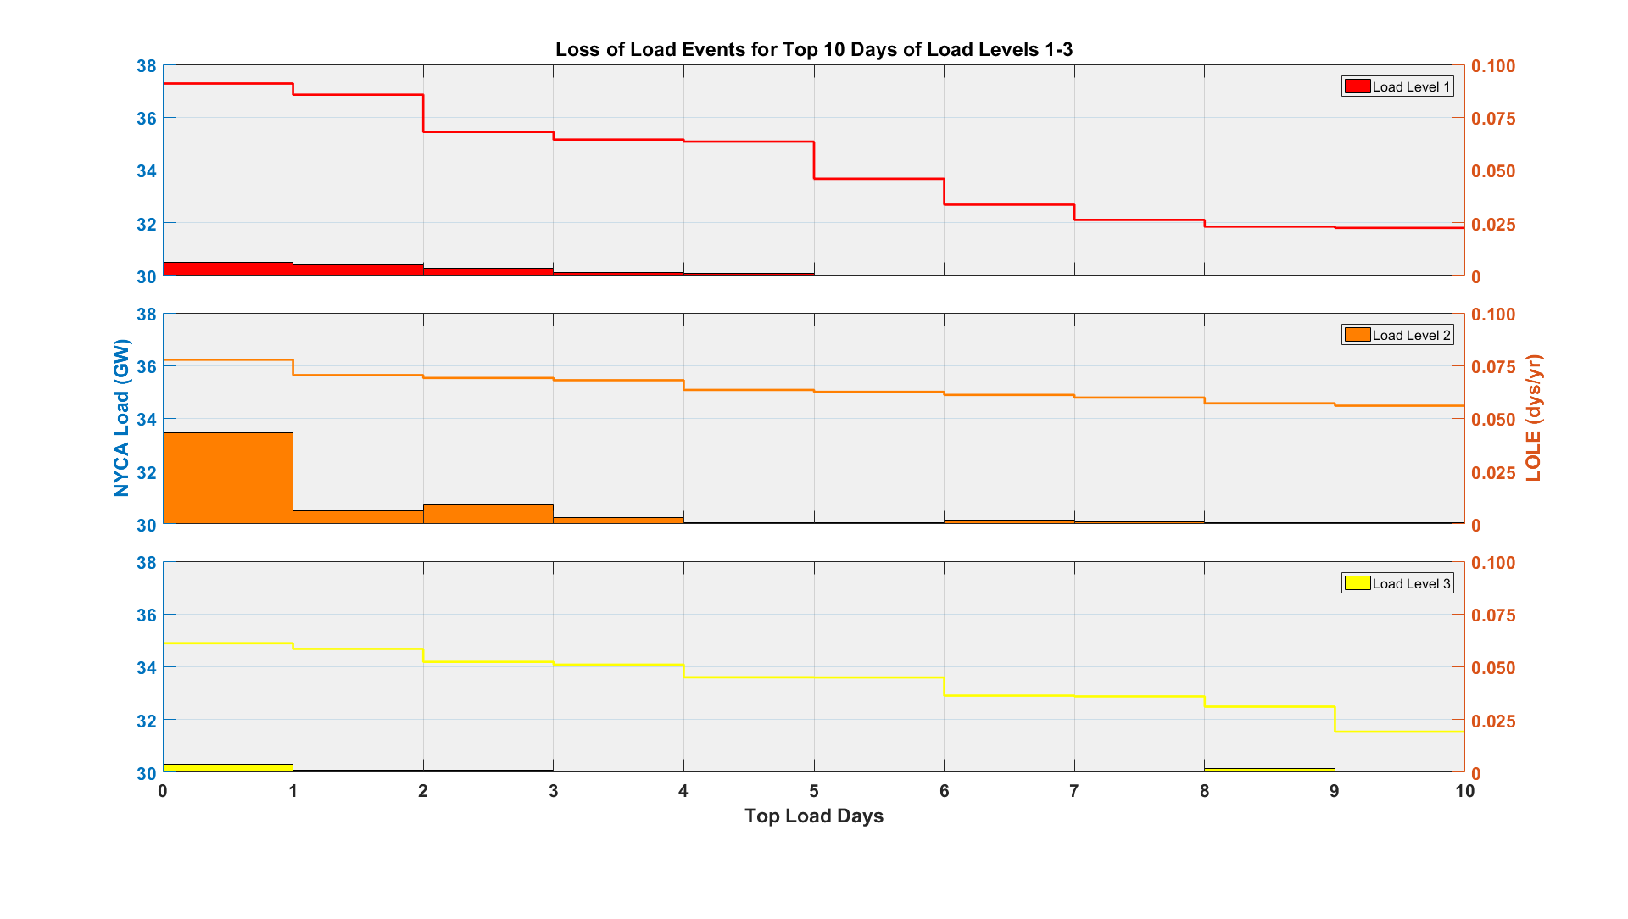
8/02
8/01
8/03
7/17
7/18
7/31
7/27
8/04
8/07
7/26
8/16
7/05
7/31
8/15
7/05
8/03
8/01
8/04
8/18
8/17
8/09
8/03
7/11
8/04
7/10
6/28
6/27
8/02
8/08
6/29

Slide 7
The Mission of the New York Independent System Operator, in collaboration with its stakeholders, is to serve the public interest and provide benefit to consumers by:
Maintaining and enhancing regional reliability
Operating open, fair and competitive wholesale electricity markets
Planning the power system for the future
Providing factual information to policy makers, stakeholders and investors in the power system
www.nyiso.com

Slide 8
Supplemental Inforamtion
INTERNAL USE ONLY

Slide 9
Reliability Metric Definitions
INTERNAL USE ONLY
Loss of Load Event (hrs/yr)
Max Value of 8760 (8784)
Loss of Load Event (dys/yr)
Max Value of 365 (366)
Reliability Criteria: 0.100
Loss of Expected Energy (MWh/yr)
Maximum Determined by Energy in Load Shape

Slide 10
IRM 2017 PBC Results
INTERNAL USE ONLY
Load Level | Base Shape | Weight | NYCA Events |  | Reliability Metrics
 |  |  | Hourly | Daily | LOLE | LOLE | LOEE
 |  |  |  |  | (hrs/yr) | (dys/yr) | (MWh/yr)
1 | 2006 | 0.0062 | 18,186 | 4,138 | 0.0752 | 0.0171 | 57.22
2 | 2002 | 0.0606 | 4,824 | 1,731 | 0.1949 | 0.0699 | 105.02
3 | 2007 | 0.2417 | 123 | 62 | 0.0198 | 0.01 | 5.4
4 | 2007 | 0.3830 | 10 | 8 | 0.0026 | 0.002 | 1.28
5 | 2007 | 0.2417 | 4 | 4 | 0.0006 | 0.0006 | 0.23
6 | 2007 | 0.0606 | 1 | 1 | 0 | 0 | 0.01
7 | 2007 | 0.0062 | 0 | 0 | 0 | 0 | 0
Total: |  | 1.0000 | 23,148 | 5,944 | 0.2931 | 0.0998 | 169.17

Slide 11
IRM 2017 PBC Results
INTERNAL USE ONLY
NYCA LFU Multipliers (Calculated)
Load Level | JAN | FEB | MAR | APR | MAY | JUN | JUL | AUG | SEP | OCT | NOV | DEC
1 | 1.04 | 1.04 | 1.04 | 1.04 | 1.12 | 1.12 | 1.12 | 1.12 | 1.12 | 1.12 | 1.04 | 1.04
2 | 1.03 | 1.03 | 1.03 | 1.03 | 1.08 | 1.09 | 1.09 | 1.09 | 1.09 | 1.08 | 1.03 | 1.03
3 | 1.02 | 1.02 | 1.02 | 1.02 | 1.05 | 1.05 | 1.05 | 1.05 | 1.05 | 1.05 | 1.02 | 1.02
4 | 1.00 | 1.00 | 1.00 | 1.00 | 0.99 | 0.99 | 0.99 | 0.99 | 0.99 | 0.99 | 1.00 | 1.00
5 | 0.98 | 0.98 | 0.98 | 0.98 | 0.94 | 0.94 | 0.94 | 0.94 | 0.94 | 0.94 | 0.98 | 0.98
6 | 0.94 | 0.94 | 0.94 | 0.94 | 0.88 | 0.88 | 0.88 | 0.88 | 0.88 | 0.88 | 0.94 | 0.94
7 | 0.91 | 0.91 | 0.91 | 0.91 | 0.83 | 0.83 | 0.83 | 0.83 | 0.83 | 0.83 | 0.91 | 0.91

Slide 12
IRM 2017 PBC Results
INTERNAL USE ONLY
LOLE (hrs/yr)
Load Level | JAN | FEB | MAR | APR | MAY | JUN | JUL | AUG | SEP | OCT | NOV | DEC | Annual
1 | 0 | 0 | 0 | 0 | 0 | 0.0000 | 0.0040 | 0.0711 | 0 | 0 | 0 | 0 | 0.0752
2 | 0 | 0 | 0 | 0 | 0.0000 | 0.0004 | 0.0453 | 0.1492 | 0 | 0.0000 | 0 | 0 | 0.1949
3 | 0 | 0 | 0 | 0 | 0.0002 | 0.0003 | 0.0027 | 0.0163 | 0.0003 | 0 | 0 | 0 | 0.0198
4 | 0 | 0 | 0 | 0 | 0 | 0 | 0.0003 | 0.0020 | 0.0003 | 0 | 0 | 0 | 0.0026
5 | 0 | 0 | 0 | 0 | 0 | 0 | 0 | 0.0007 | 0 | 0 | 0 | 0 | 0.0007
6 | 0 | 0 | 0 | 0 | 0 | 0 | 0 | 0.0000 | 0 | 0 | 0 | 0 | 0.0000
7 | 0 | 0 | 0 | 0 | 0 | 0 | 0 | 0 | 0 | 0 | 0 | 0 | 0
Total: | 0 | 0 | 0 | 0 | 0.0002 | 0.0007 | 0.0523 | 0.2393 | 0.0006 | 0.0000 | 0 | 0 | 0.2931

Slide 13
IRM 2017 PBC Results
INTERNAL USE ONLY
LOEE (MWh/yr)
Load Level | JAN | FEB | MAR | APR | MAY | JUN | JUL | AUG | SEP | OCT | NOV | DEC | Annual
1 | 0 | 0 | 0 | 0 | 0 | 0.00 | 0.62 | 56.60 | 0 | 0 | 0 | 0 | 57.22
2 | 0 | 0 | 0 | 0 | 0.01 | 0.15 | 15.31 | 89.54 | 0 | 0.02 | 0 | 0 | 105.02
3 | 0 | 0 | 0 | 0 | 0.04 | 0.05 | 0.62 | 4.55 | 0.15 | 0 | 0 | 0 | 5.41
4 | 0 | 0 | 0 | 0 | 0 | 0 | 0.01 | 1.18 | 0.09 | 0 | 0 | 0 | 1.28
5 | 0 | 0 | 0 | 0 | 0 | 0 | 0 | 0.23 | 0 | 0 | 0 | 0 | 0.23
6 | 0 | 0 | 0 | 0 | 0 | 0 | 0 | 0.01 | 0 | 0 | 0 | 0 | 0.01
7 | 0 | 0 | 0 | 0 | 0 | 0 | 0 | 0 | 0 | 0 | 0 | 0 | 0
Total: | 0 | 0 | 0 | 0 | 0.05 | 0.21 | 16.56 | 152.10 | 0.24 | 0.02 | 0 | 0 | 169.17

Slide 14
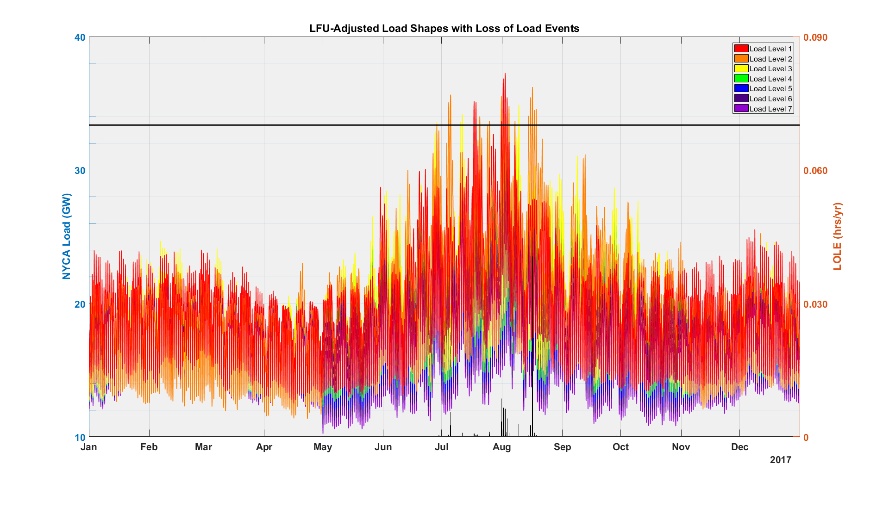
INTERNAL USE ONLY
Peak Hour, Load Level 1
Peak Load: 33,363 MW
Peak Hour, Load Level 2
Peak Hour, Load Level 3
Peak Load: 33,363 MW

Slide 15
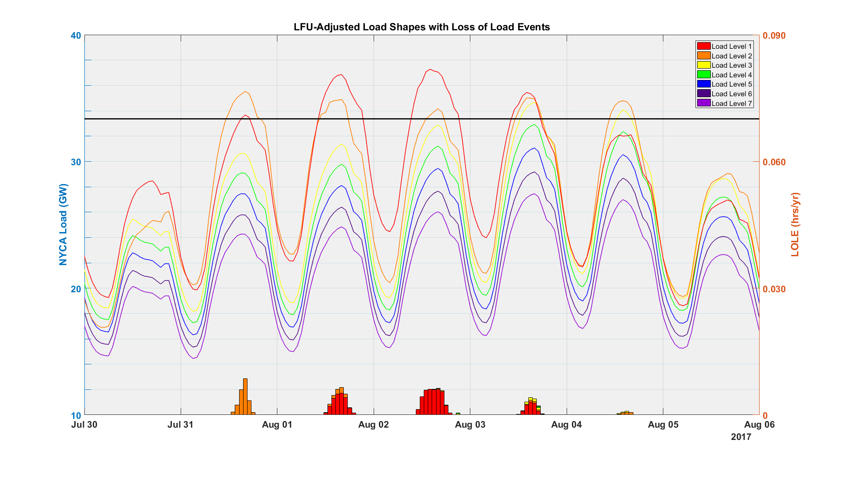
INTERNAL USE ONLY
Peak Hour, Load Level 1
Peak Load: 33,363 MW
Up To 6 hrs
Up To 8 hrs
Up To 9 hrs
Up To 7 hrs
Up To 4 hrs
(No Events)
(No Events)

Slide 16
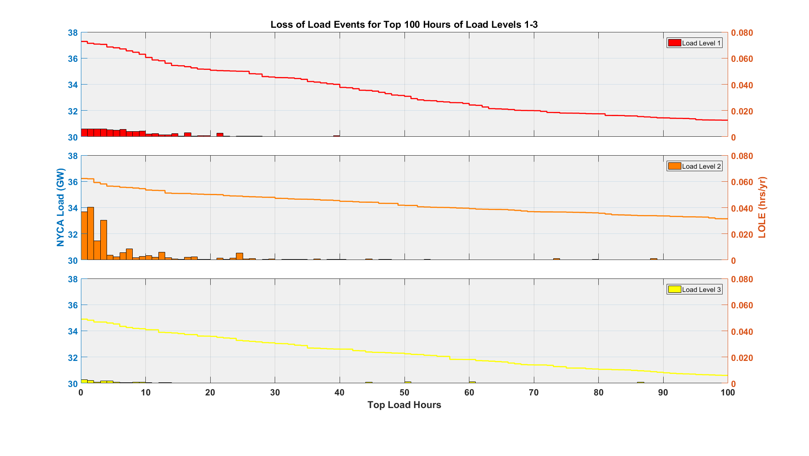
INTERNAL USE ONLY

Slide 17
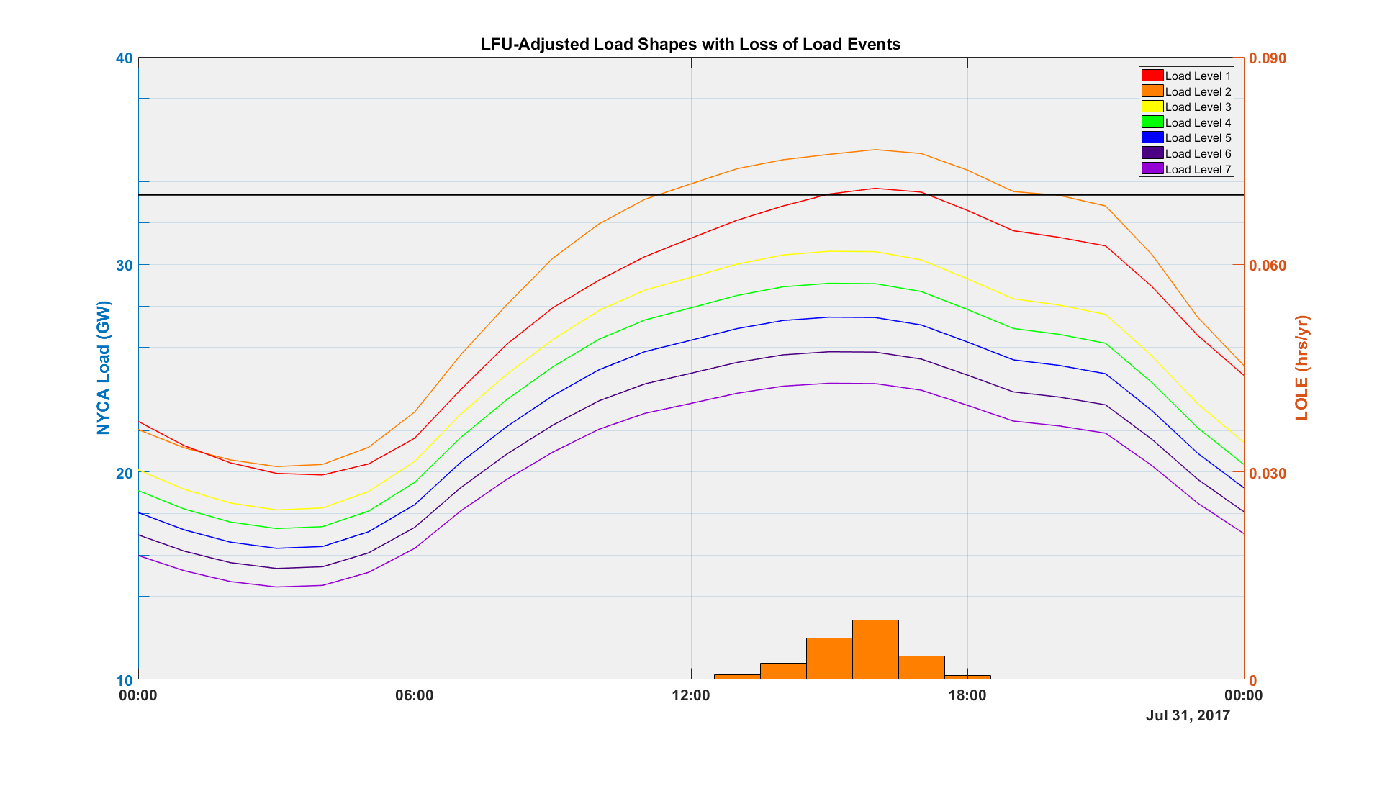
INTERNAL USE ONLY
Loss of Load Hours
Peak Load: 33,363 MW
Up to 6 hours in duration, Level 2
Monday

Slide 18
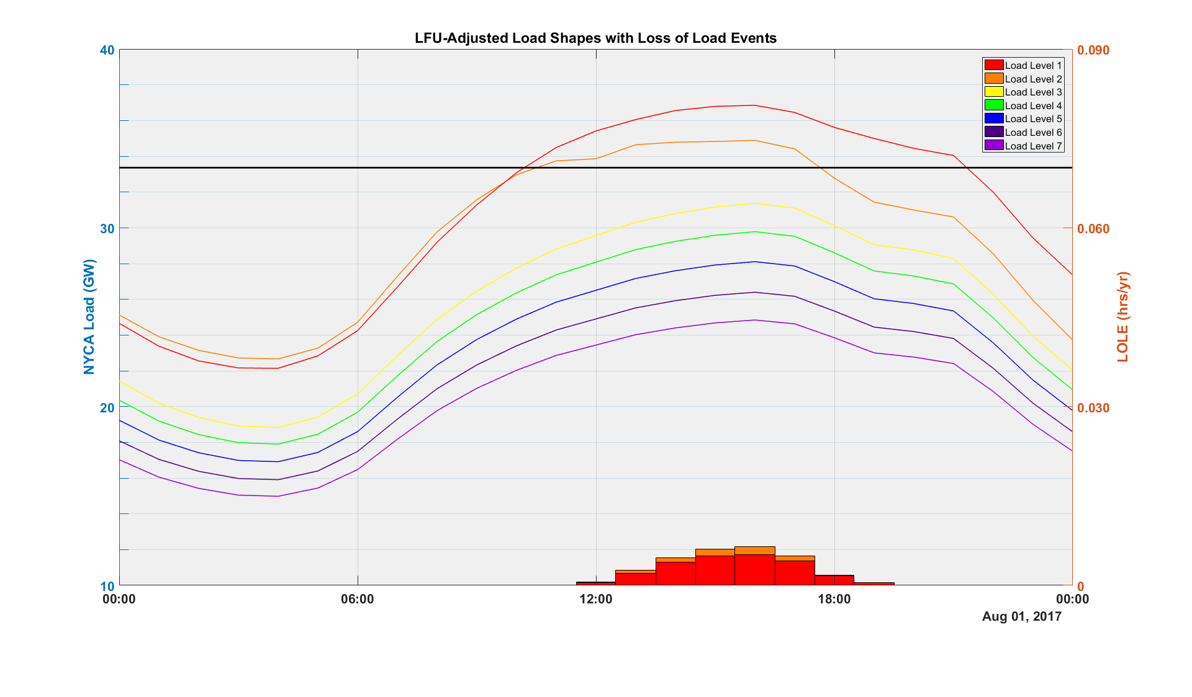
INTERNAL USE ONLY
Loss of Load Hours
Peak Load: 33,363 MW
Up to 8 hours in duration, Level 1
Up to 5 hours in duration, Level 2
Tuesday

Slide 19
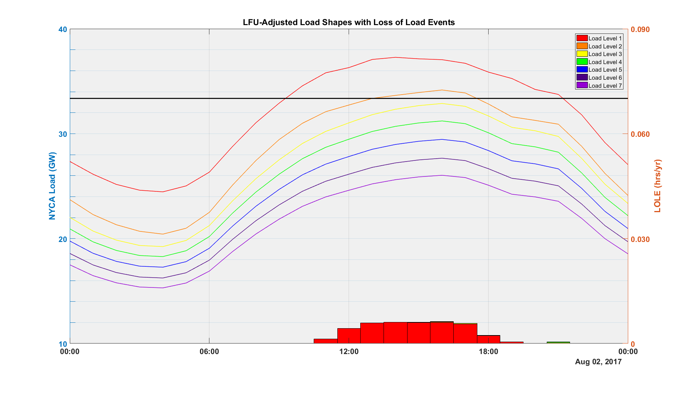
INTERNAL USE ONLY
Peak Load: 33,363 MW
Wednesday

Slide 20
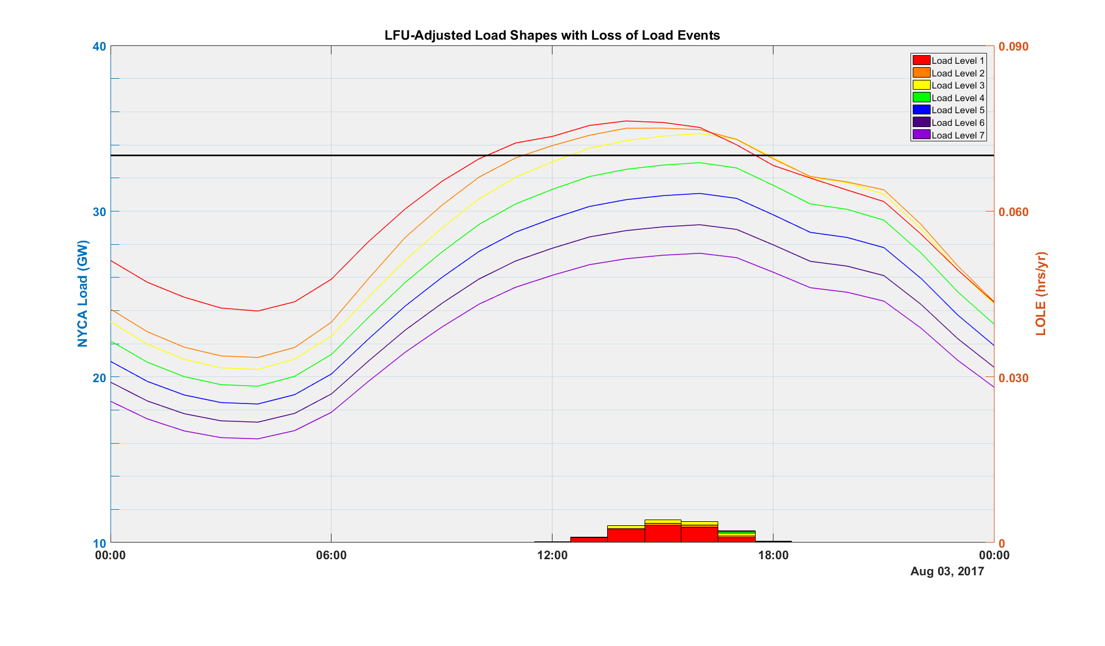
INTERNAL USE ONLY
Peak Load: 33,363 MW
Thursday

Slide 21
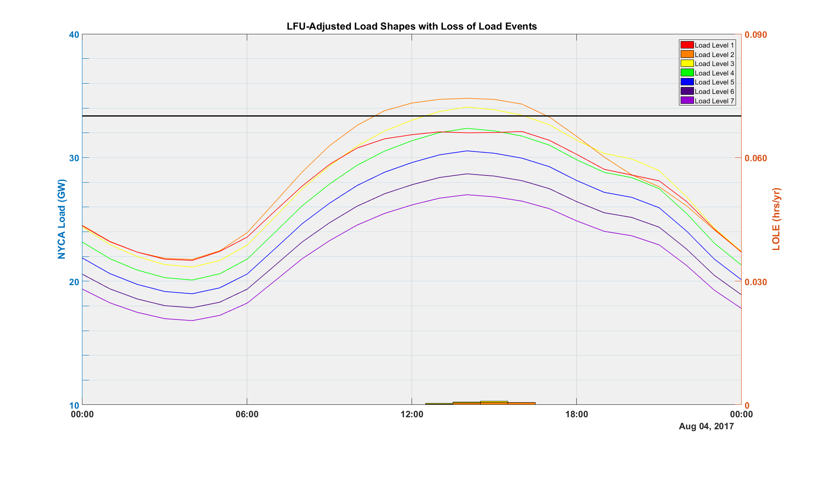
INTERNAL USE ONLY
Peak Load: 33,363 MW
Friday

